Slide 1


INTRODUCTION ON
Generative Models
Presented By:
Sarthak & Sujanu

Slide 2
INTRODUCTION
A generative model is a type of machine learning model.
Trained to generate new data similar to the data it was trained on.
These models are able to learn the underlying patterns and distributions in the training data.
The knowledge gained is used to generate new samples that are similar to the training data.

Slide 3
BACKGROUND
In statistical classification, two main approaches are called the generative approach and the discriminative approach.
Generative models capture the joint probability p(X, Y).
Discriminative models capture the conditional probability
p(Y | X).

Slide 4
Behind The Scenes
PDF describes the probability of a random variable taking on a particular value or a range of values.
Likelihood function is used to evaluate how well the model fits the training data and to guide the training process.
  In Variational Autoencoder, the likelihood is factorized as:
  p(x|z)p(z) = p(x,z)
  Where x is the input data, and z is the latent variable.

Slide 5
Behind The Scenes
The Kullback-Leibler divergence is used as a loss function
-It measures the difference between two probability distributions.
A common form of this loss function is:
KL(q(z|x) || p(z)) = - ∫ q(z|x) log (p(z)) dz + ∫ q(z|x) log(q(z|x)) dz
During the training of VAE the network tries to minimize this loss.

Slide 6
TYPES
Generative Adversarial Networks (GANs)
Variational Autoencoder (VAE)
Autoregressive Models

Slide 7
Generative Adversarial Networks (GANs)
A model that consists of two neural networks:
  Generator network
    It is trained to generate new samples
  Discriminator network
    It is trained to distinguish between the generated samples and the training data.

Slide 8
Variational Autoencoder (VAE)
A type of neural network.
It is trained to learn a compact latent representation of the data.
It generate new samples from this latent representation.
VAEs are powerful tool for unsupervised learning, where no explicit labels are available.

Slide 9
Autoregressive Models
It generates sequence data, like text.
It predicting the next token of the sequence, given the previous tokens.
The most common example for this is Transformer-based Language models, like GPT-3.

Slide 10
APPLICATION
Image synthesis
Video generation
Text-to-speech synthesis
Language modeling
Music generation
Anomaly detection

Slide 11
Algorithm for training a generative model:
Define the generative model, which can include a generator network, a discriminator network, or both depending on the type of model.
Initialize the model parameters.
Load the training data, which can be any type of data such as images, videos, audio, or text.
Define a loss function that measures the difference between the generated samples and the training data.
Define an optimization algorithm, such as gradient descent, to update the model parameters based on the loss.
For each training iteration:
  Sample a batch of data from the training set.
  Generate samples using the generator network and compute the loss.
  Update the model parameters using the optimization algorithm and the computed gradients.
Repeat step 6 for a predefined number of iterations or until the loss converges.
Once the training process is finished, the generative model can be used to generate new samples by sampling from the learned distribution or by applying the generator network on a random noise.

Slide 12
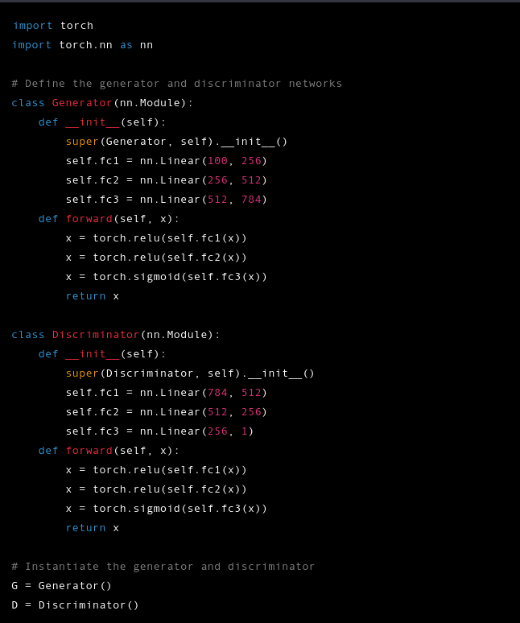
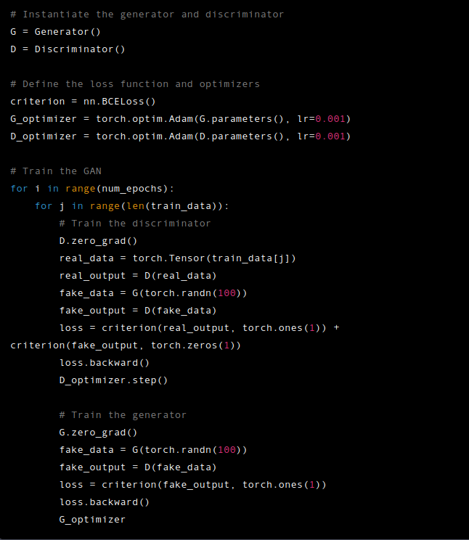
Fig: sample code for GAN using PyTorch

Slide 13
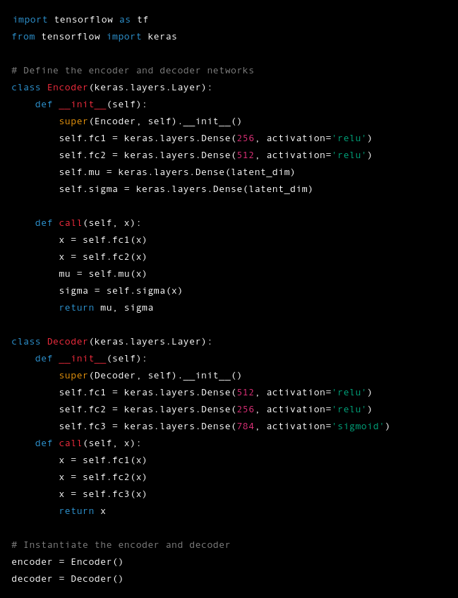
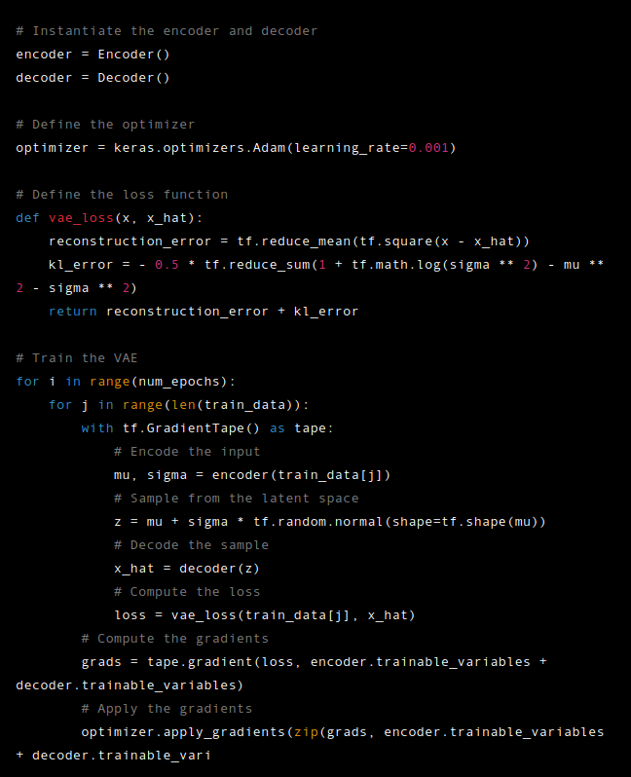
Fig: sample code for VAE using Keras

Slide 14

THANK YOU

Slide 15
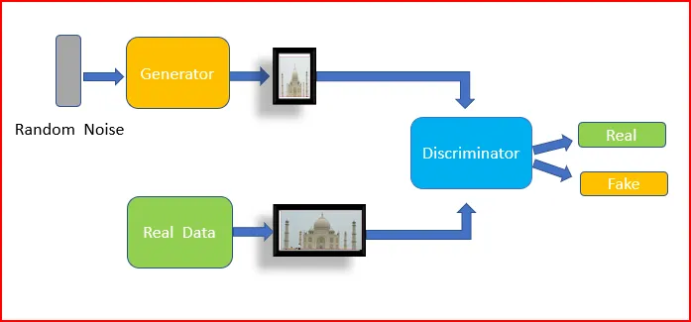
Generative Adversarial Networks (GANs)
A model that consists of two neural networks:
  Generator network
    It is trained to generate new samples
  Discriminator network
    It is trained to distinguish between the generated samples and the training data.

Slide 16
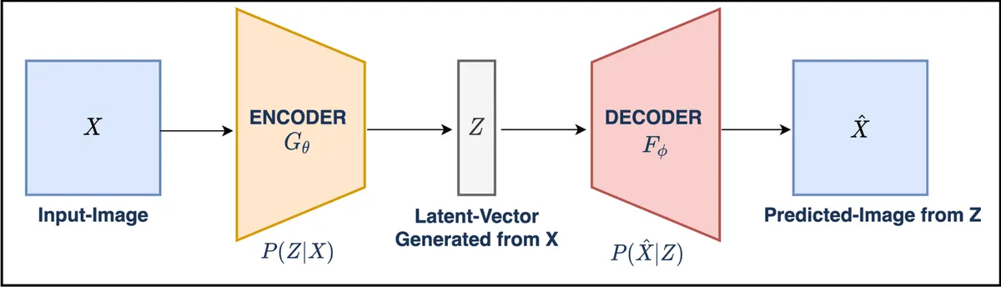
Variational Autoencoder (VAE)
A type of neural network.
It is trained to learn a compact latent representation of the data.
It generate new samples from this latent representation.
VAEs are powerful tool for unsupervised learning, where no explicit labels are available.

Slide 17
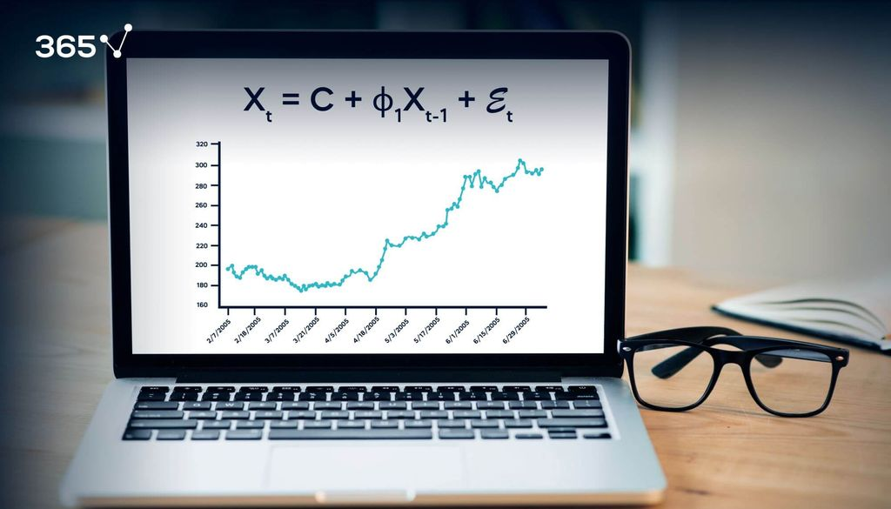
Autoregressive Models
It generates sequence data, like text.
It predicting the next token of the sequence, given the previous tokens.
The most common example for this is Transformer-based Language models, like GPT-3.

Slide 18
Reviewed By:
1. Trilochan Kafle
2. Bhoj Raj Mishra
3. Prabesh Rijal

